Slide 1
8.卷积神经网络

Slide 2
CNN的早期历史
卷积神经网络CNN
K. Fukushima, “Neocognitron: A self-organizing neural network model for a mechanism of pattern recognition unaffected by shift in position,” Biological Cybernetics, vol. 36, pp. 193–202, 1980
Y. LeCun, B. Boser, J. S. Denker, D. Henderson, R. E. Howard, W. Hubbard, and L. D. Jackel, “Backpropagation applied to handwritten zip code recognition,” Neural Computation, vol. 1, no. 4, pp. 541–551, 1989
Y. Le Cun, L. Bottou, Y. Bengio, and P. Haffner, “Gradient-based learning applied to document recognition,” Proceedings of the IEEE, vol. 86, no. 11, pp. 2278–2324, 1998

Slide 3
DL时代的CNN扩展
A Krizhevsky, I Sutskever, GE Hinton. ImageNet classification with deep convolutional neural networks. NIPS2012
Y. Jia et al. Caffe: Convolutional Architecture for Fast Feature Embedding. ACM MM2014
K. Simonyan, A. Zisserman. Very deep convolutional networks for large-scale image recognition. arXiv preprint arXiv:1409.1556, 2014
C. Szegedy, W. Liu, Y. Jia, P. Sermanet, S. Reed, D. Anguelov, D. Erhan, V. Vanhoucke, A.Rabinovich. Going deeper with convolutions. CVPR2015 (&arXiv:1409.4842, 2014)

Slide 4
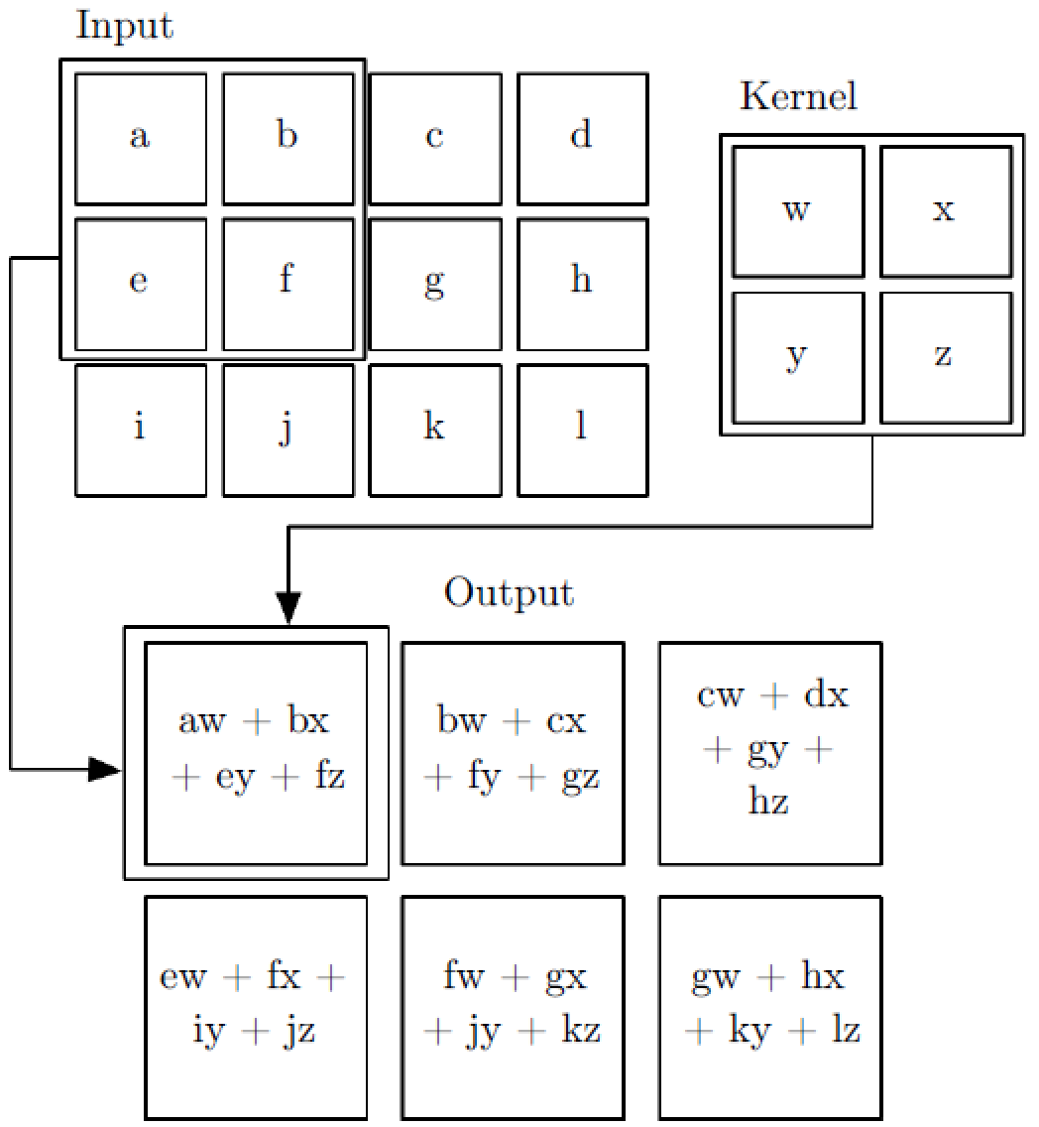
卷积——示例

Slide 5
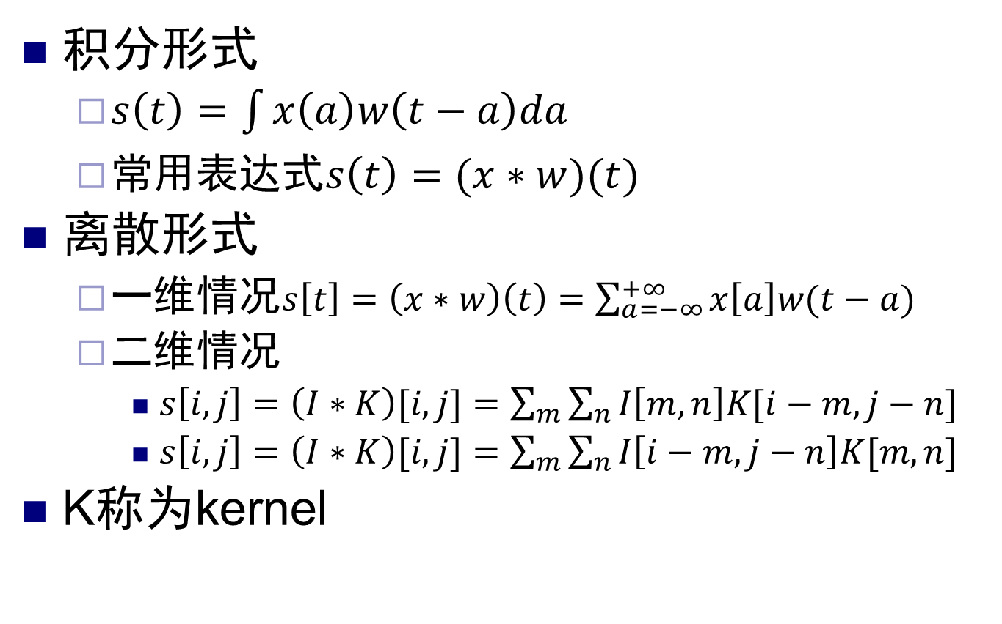
卷积——形式化
积分形式
$s\left(t\right)=\int{x\left(a\right)w\left(t−a\right)da}$
常用表达式$s\left(t\right)=(x∗w)(t)$
离散形式
一维情况$s\left[t\right]=\left(x∗w\right)\left(t\right)=\sum_{a=−∞}^{+∞}{x\left[a\right]w(t−a)}$
二维情况
$s\left[i,j\right]=\left(I∗K\right)[i,j]=\sum_{m}{\sum_{n}{I\left[m,n\right]K[i−m,j−n]}}$
$s\left[i,j\right]=\left(I∗K\right)[i,j]=\sum_{m}{\sum_{n}{I\left[i−m,j−n\right]K[m,n]}}$
K称为kernel

Slide 6
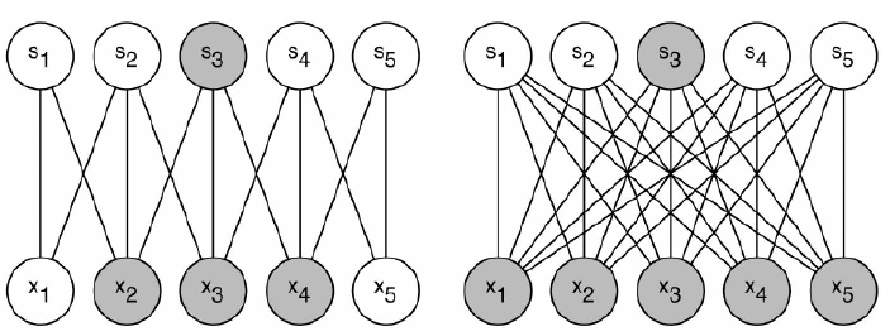
卷积——why?
1. sparse interactions
有限连接，Kernel比输入小
连接数少很多，学习难度小，计算复杂度低
m个节点与n个节点相连O(mn)
限定k(<<m)个节点与n个节点相连，则为O(kn)
Notes:
parameter sharing

Slide 7
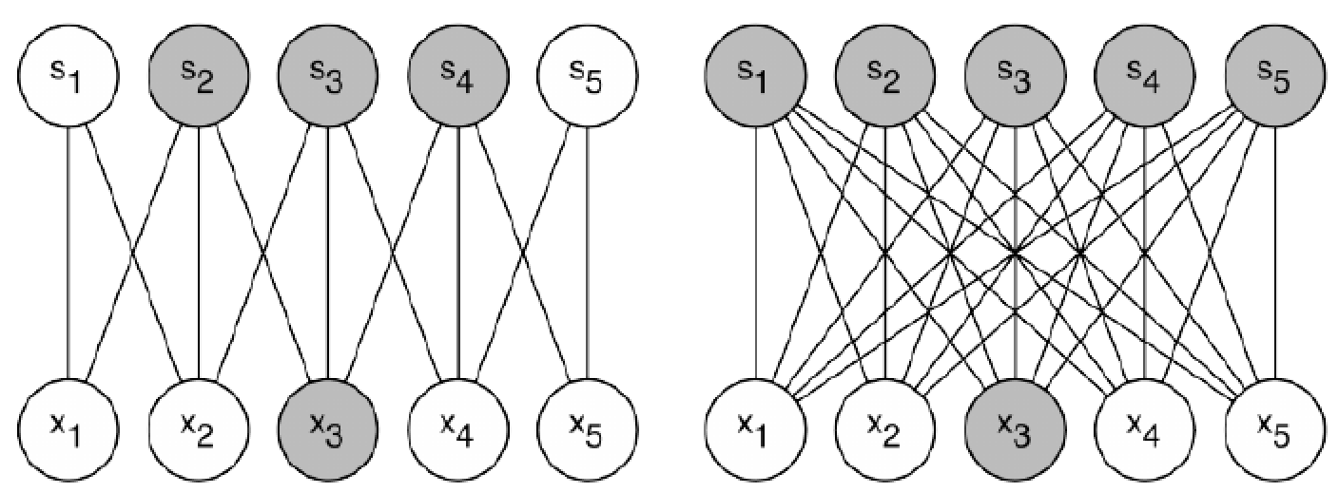
卷积——why?
1. sparse interactions
有限连接，Kernel比输入小
连接数少很多，学习难度小，计算复杂度低
m个节点与n个节点相连O(mn)
限定k(<<m)个节点与n个节点相连，则为O(kn)
Notes:
parameter sharing
equivariant representations.

Slide 8
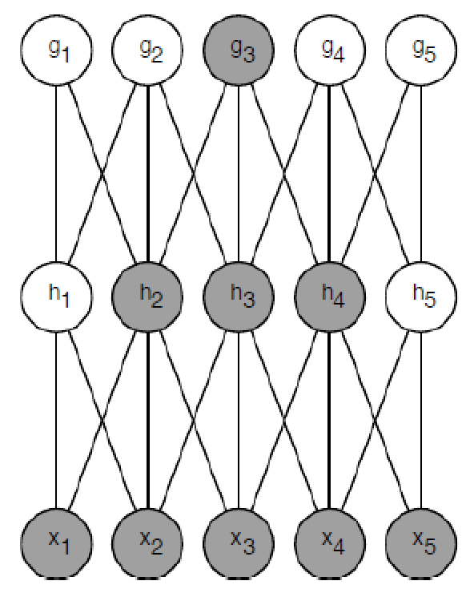
卷积——why?
1. sparse interactions
有限(稀疏)连接
Kernel比输入小
局部连接
连接数少很多
学习难度小
计算复杂度低
层级感受野（生物启发）
越高层的神经元，感受野越大
Notes:
equivariant representations.

Slide 9
卷积——why?
2. Parameter Sharing（参数共享）
Tied weights
进一步极大的缩减参数数量
3. Equivariant representations
等变性
配合Pooling可以获得平移不变性
对scale和rotation不具有此属性

Slide 10
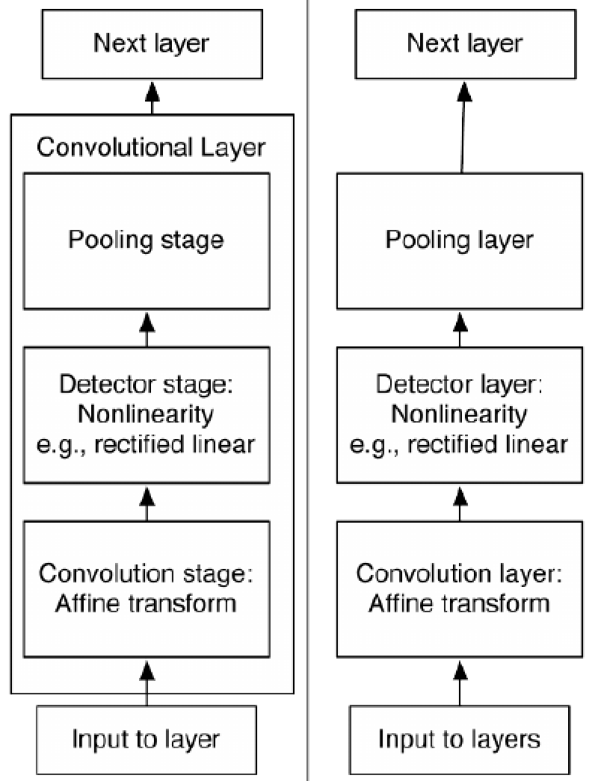
CNN的基本结构
三个步骤
卷积
突触前激活，net
非线性激活
Detector
Pooling
Layer的两种定义
复杂定义
简单定义
有些层没有参数

Slide 11
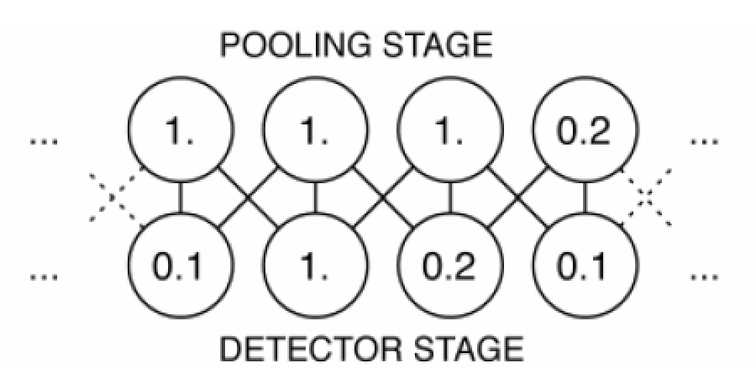
Pooling
定义（没有需要学习的参数）
replaces the output of the net at a certain location with a summary statistic of the nearby outputs
种类
max pooling
(weighted) average pooling

Slide 12
Why Pooling?
获取不变性
小的平移不变性：有即可，不管在哪里
很强的先验假设The function the layer learns must be invariant to small translations

Slide 13
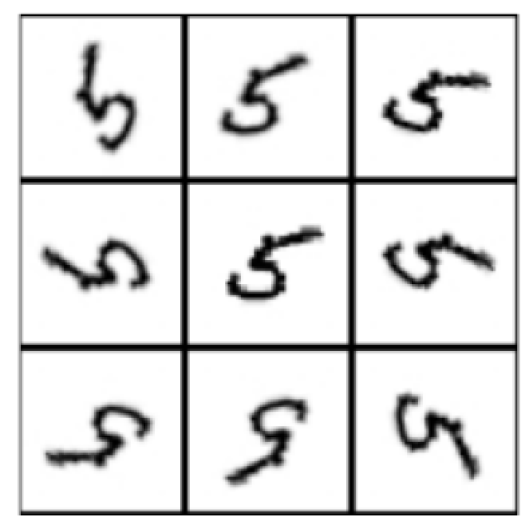

Why Pooling?
获取不变性
小的平移不变性：有即可，不管在哪里
旋转不变性？
9个不同朝向的kernels（模板）
0.2 | 0.6 | 1
0.1 | 0.5 | 0.3
0.02 | 0.05 | 0.1

Slide 14
Why Pooling?
获取不变性
小的平移不变性：有即可，不管在哪里
旋转不变性？
9个不同朝向的kernels（模板）
0.5 | 0.3 | 0.02
1 | 0.4 | 0.3
0.6 | 0.3 | 0.1

Slide 15
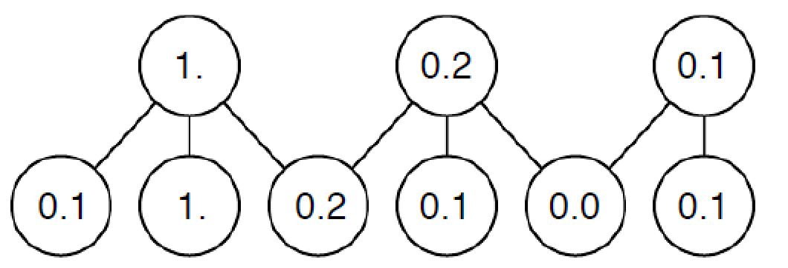
Pooling与下采样结合
更好的获取平移不变性
更高的计算效率（减少了神经元数）

Slide 16
从全连接到有限连接
部分链接权重被强制设置为0
通常：非邻接神经元，仅保留相邻的神经元
全连接网络的特例，大量连接权重为0

Slide 17
Why Convolution & Pooling？
a prior probability distribution over the parameters of a model that encodes our beliefs about what models are reasonable, before we have seen any data.
模型参数的先验概率分布(No free lunch)
在见到任何数据之前，我们的信念（经验）告诉我们，什么样的模型参数是合理的
Local connections；对平移的不变性；tied weigts
来自生物神经系统的启发

Slide 18
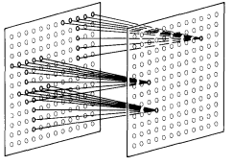
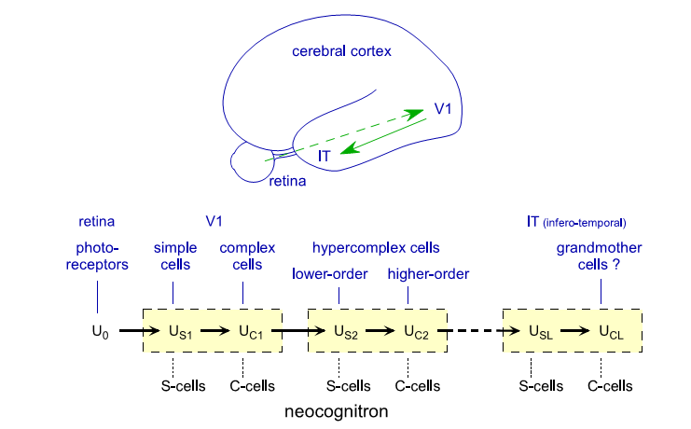
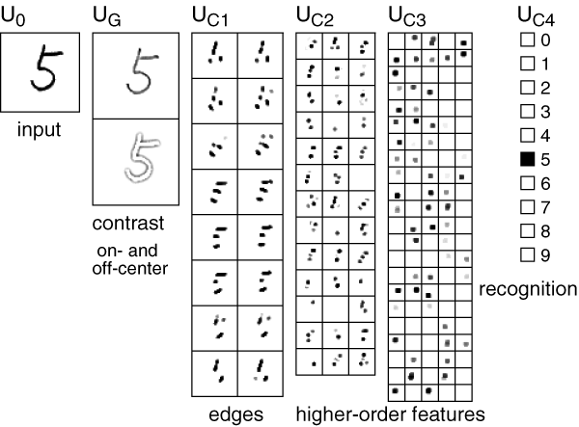
源起：Neocognitron (1980)
Simple→complex
Lower order→high order
Local Connection
K. Fukushima, “Neocognitron: A self-organizing neural network model for a mechanism of pattern recognition unaffected by shift in position,” Biological Cybernetics, vol. 36, pp. 193–202, 1980

Slide 19
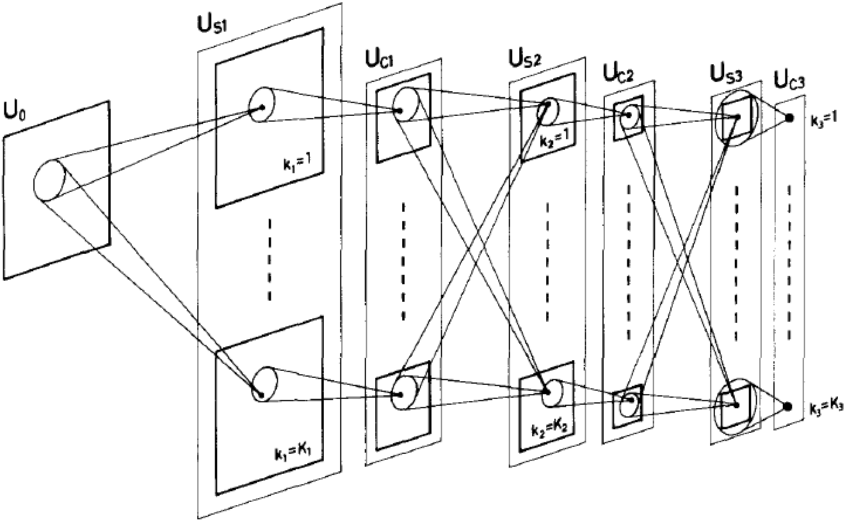
源起：Neocognitron (1980)

Slide 20
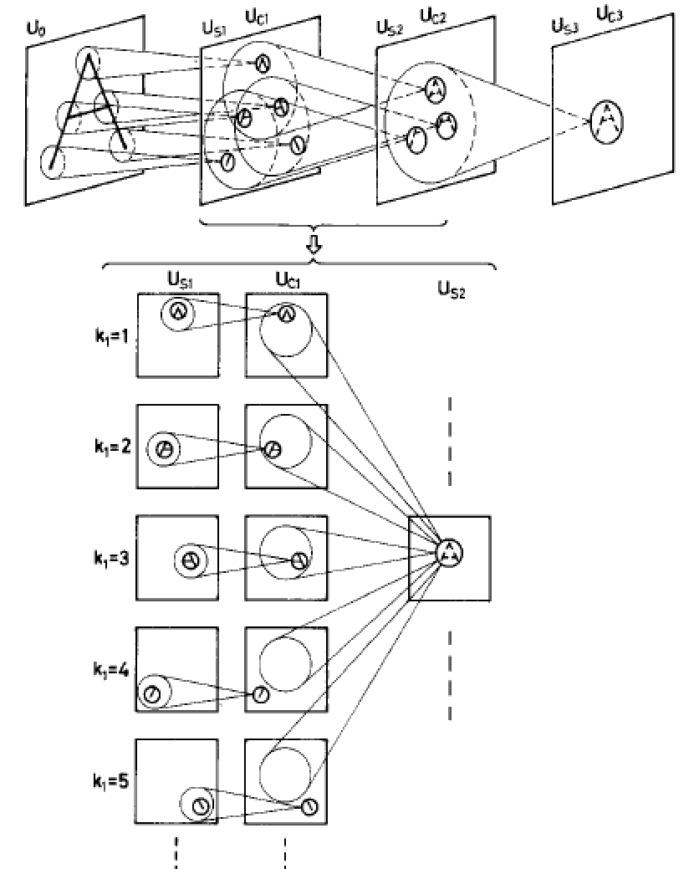
源起：Neocognitron (1980)
训练方法
分层
自组织
competitive learning
无监督
输出层
独立训练
有监督

Slide 21
LeCun-CNN1989—用于字符识别
简化了Neocognitron的结构
训练方法
监督训练
BP算法
正切函数收敛更快，Sigmoid Loss，SGD
用于邮编识别
大量应用

Slide 22
LeCun-CNN1989—用于字符识别
输入
16x16图像
L1—H1
12个5x5 kernel
8x8个神经元
L2--H2
12个5x5x8 kernel
4x4个神经元
L3—H3
30个神经元
L4—输出层
10个神经元
总连接数
5*5*12*64+5*5*8*12*16+192*30，约66,000个

Slide 23
LeCun-CNN1989—用于字符识别
Tied weights
对同一个feature map，kernel对不同位置是相同的！

Slide 24
LeCun-CNN1989—用于字符识别

Slide 25
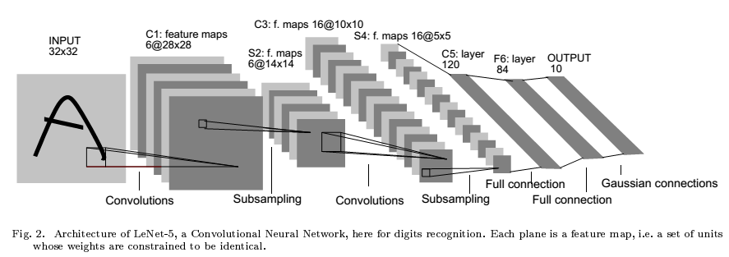
1998年LeNet——数字/字符识别
LeNet-5
Feature map
a set of units whose weighs are constrained to be identical.

Slide 26
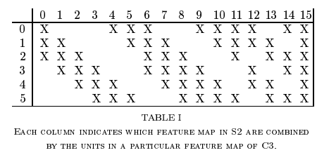
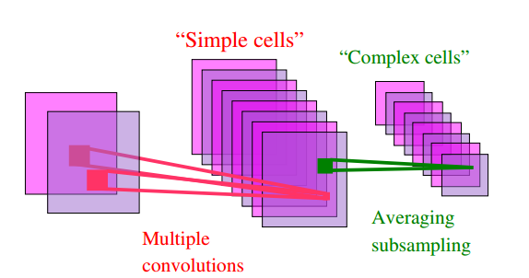
1998年LeNet——数字/字符识别
例如：C3层参数个数
(3*6+4*9+6*1)*25 + 16 = 1516

Slide 27
后续：CNN用于目标检测与识别

Slide 28
AlexNet for ImageNet (2012)
大规模CNN网络
650K神经元
60M参数
使用了各种技巧
Dropout
Data augment
ReLU
Local Response Normalization
Contrast normalization
...
Krizhevsky, Alex, Ilya Sutskever, and Geoffrey E. Hinton. "Imagenet classification with deep convolutional neural networks." Advances in neural information processing systems. 2012.

Slide 29
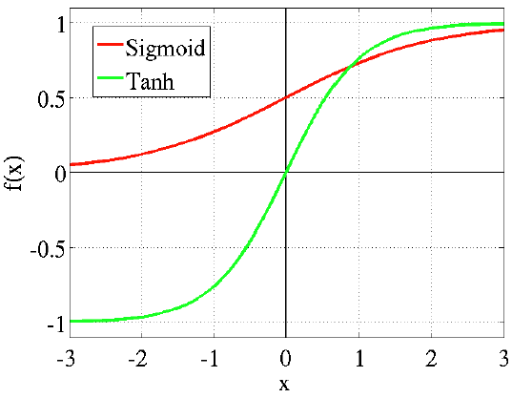
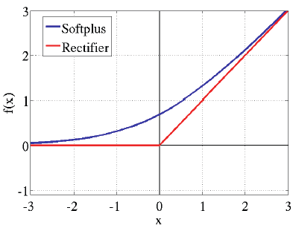
AlexNet for ImageNet (2012)
ReLU激活函数

Slide 30
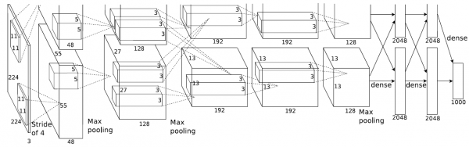
AlexNet for ImageNet (2012)
实现
2块GPU卡
输入层150,528
其它层253,440→186,624 → 64,896 → 64,896 → 43,264 → 4096 → 4096 → 1000.
Krizhevsky, Alex, Ilya Sutskever, and Geoffrey E. Hinton. "Imagenet classification with deep convolutional neural networks." Advances in neural information processing systems. 2012.

Slide 31
AlexNet for ImageNet (2012)
ImageNet物体分类任务上
1000类，1,431,167幅图像
Rank | Name | Error rates(TOP5) | Description
1 | U. Toronto | 0.153 | Deep learning
2 | U. Tokyo | 0.261 | Hand-crafted features and learning models. Bottleneck.
3 | U. Oxford | 0.270
4 | Xerox/INRIA | 0.271
Krizhevsky, Alex, Ilya Sutskever, and Geoffrey E. Hinton. "Imagenet classification with deep convolutional neural networks." Advances in neural information processing systems. 2012.

Slide 32
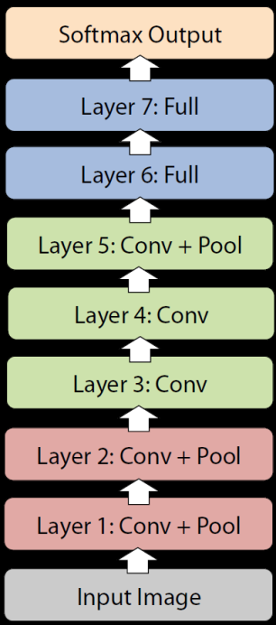
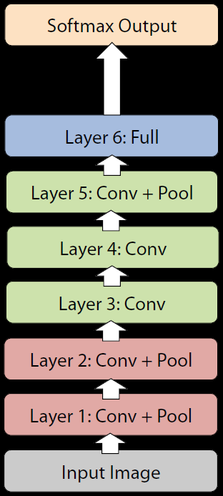
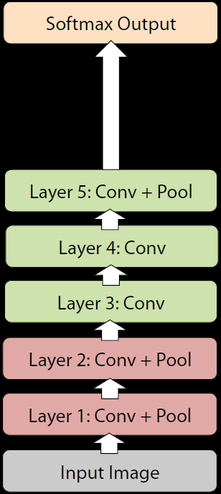
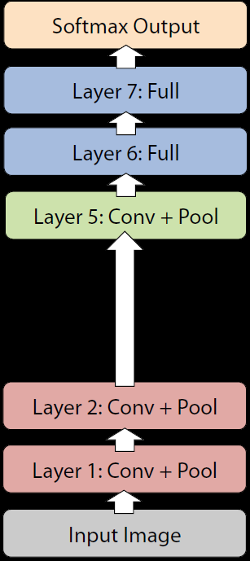
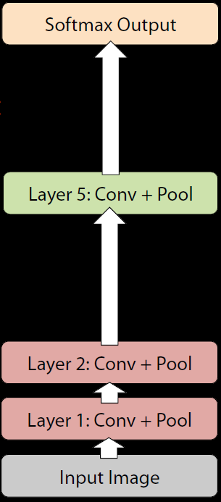
AlexNet for ImageNet
深度的重要性
网络深度 | 8 | 7 | 6 | 6 | 4
参数数量 | 60M | 44M | 10M | 59M | 10M
性能损失 | 0% | 1.1% | 5.7% | 3.0% | 33.5%
Krizhevsky, Alex, Ilya Sutskever, and Geoffrey E. Hinton. "Imagenet classification with deep convolutional neural networks." Advances in neural information processing systems. 2012.

Slide 33
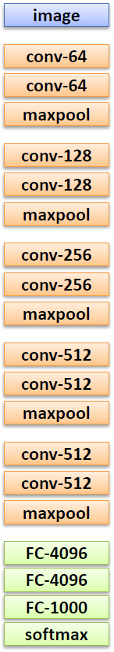
VGG Net (2014)
多个stage
每个stage多个卷积层
卷积采样间隔1x1
卷积核大小3x3
1个Pooling层(2x2)
16-19层
多尺度融合
K. Simonyan, A. Zisserman. Very deep convolutional networks for large-scale image recognition. arXiv preprint arXiv:1409.1556, 2014

Slide 34
VGG Net (2014)
几种配置
Cov3-64:
3x3感受野
64个channel
K. Simonyan, A. Zisserman. Very deep convolutional networks for large-scale image recognition. arXiv preprint arXiv:1409.1556, 2014

Slide 35
VGG Net (2014)
K. Simonyan, A. Zisserman. Very deep convolutional networks for large-scale image recognition. arXiv preprint arXiv:1409.1556, 2014

Slide 36
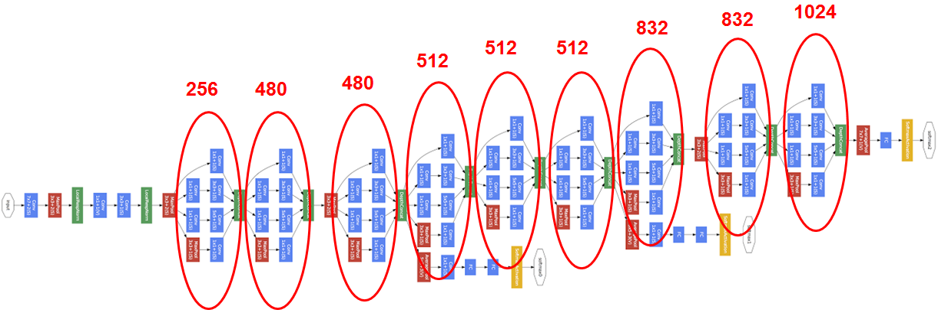
GoogLeNet (2014)
超大规模
22个卷积层的网络
计算复杂度是AlexNet的4倍左右
C. Szegedy, W. Liu, Y. Jia, P. Sermanet, S. Reed, D. Anguelov, D. Erhan, V. Vanhoucke, A.Rabinovich. Going deeper with convolutions. CVPR2015 (&arXiv:1409.4842, 2014)

Slide 37
GoogLeNet (2014)
超大规模24层网络
Inception结构
提取不同scale的特征
然后串接起来
Filter concatenation
1x1 convolutions
3x3 convolutions
5x5 convolutions
Previous layer
C. Szegedy, W. Liu, Y. Jia, P. Sermanet, S. Reed, D. Anguelov, D. Erhan, V. Vanhoucke, A.Rabinovich. Going deeper with convolutions. CVPR2015 (&arXiv:1409.4842, 2014)

Slide 38
GoogLeNet (2014)
超大规模24层网络
Inception结构
提取不同scale的特征，然后串接起来
增加1x1的卷积：把响应图的数量缩小了
Filter concatenation
3x3 convolutions
5x5 convolutions
1x1 convolutions
1x1 convolutions
1x1 convolutions
1x1 convolutions
3x3 max pooling
Previous layer
C. Szegedy, W. Liu, Y. Jia, P. Sermanet, S. Reed, D. Anguelov, D. Erhan, V. Vanhoucke, A.Rabinovich. Going deeper with convolutions. CVPR2015 (&arXiv:1409.4842, 2014)

Slide 39
GoogLeNet (2014)
C. Szegedy, W. Liu, Y. Jia, P. Sermanet, S. Reed, D. Anguelov, D. Erhan, V. Vanhoucke, A.Rabinovich. Going deeper with convolutions. CVPR2015 (&arXiv:1409.4842, 2014)

Slide 40
GoogLeNet (2014)
在ImageNet上1000类物体分类上的性能
C. Szegedy, W. Liu, Y. Jia, P. Sermanet, S. Reed, D. Anguelov, D. Erhan, V. Vanhoucke, A.Rabinovich. Going deeper with convolutions. CVPR2015 (&arXiv:1409.4842, 2014)

